Slide 1
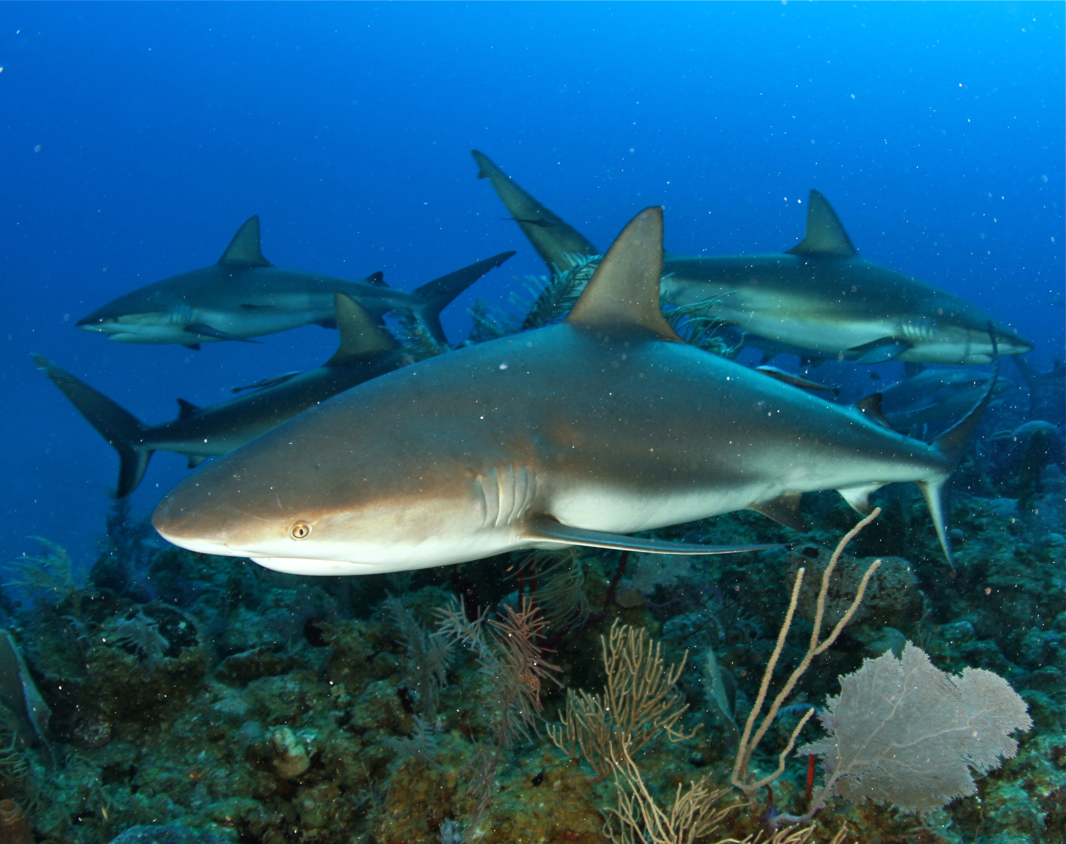
The importance of fish spawning aggregations to reef-associated sharks
R. T. Graham¹, K. L. Rhodes², R. S. Nemeth³, G. Burgess⁴, D. Castellanos
1. Wildlife Conservation Society, 2. University of Hawaii at Hilo
3. University of the US Virgin Islands, 4. University of Florida
Notes:
12 minutes max
The importance of fish spawning aggregations to reef-associated sharks
Reef fish spawning aggregations and reef-associated sharks are increasingly becoming trigger points for site based and species focused conservation measures yet sparse information exists on the relationship between the two. Underwater visual monitoring and the deployment of acoustic arrays coupled with the acoustic tagging of both predators and prey suggest strong seasonal linkages and dependence of four species of reef-associated sharks on spawning reef fish. Movements of sharks were tracked inside and beyond five spawning aggregation sites and marine protected area boundaries located in Belize, Central America and Pohnpei, Micronesia. In the Caribbean, Carcharhinus perezi demonstrated preferential visitation rates to three sites on Lighthouse Reef Atoll, Belize, that support reproductive aggregations of Epinephelus striatus, Lutjanus cyanopterus and Mycteroperca tigris respectively. Gladden Spit Marine Reserve, Belize, hosts strong seasonal site fidelity of C. leucas and Rhincodon typus that target different two life stages of L. cyanopterus, L. jocu and L. analis that aggregate to spawn. In the Pacific, C. amblyrhynchos females demonstrated strong site fidelity to the Kephara Marine Reserve in Pohnpei during the peak aggregations of Epinephelus fuscoguttatus occurring prior to known period of parturition. Following cessation of spawning events, sharks altered visitation patterns to spawning aggregation sites, occasionally undertaking broad movements to other feeding grounds. We demonstrate that the predictable dependence of reef-associated sharks on reef fish spawning aggregations provides the basis for non-consumptive economic alternatives to fisheries through tourism and cost-effective solution to the conservation of reef-associated predators.

Slide 2
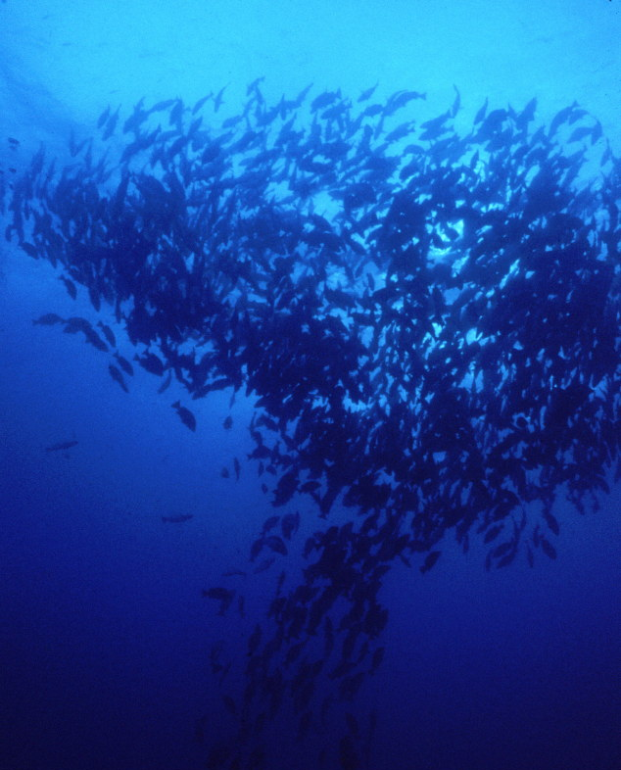
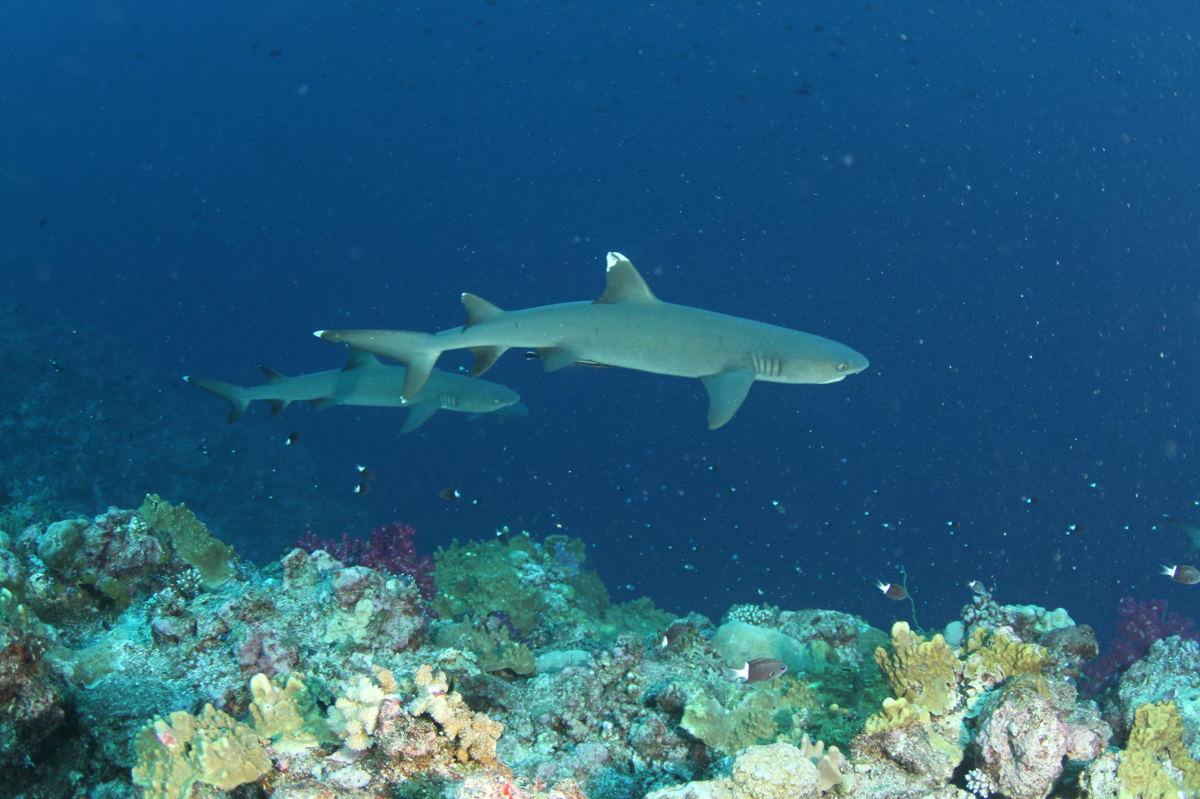
Study catalysts
Decline of reef-associated shark (RAS) populations in both populated and remote areas ¹
Overall declines of fish spawning aggregations (FSA)²
Identification of linkages between RAS and FSA,
  Impacts of predators on FSA
  Importance of FSA for shark provisioning
Need to stretch limited resources for the conservation and management of RAS and FSA
1. Robbins et al. 2006; Graham et al. 2010;
2. Sadovy 1994; Sadovy & Eklund 1999; Sala et al. 2001
Notes:
3 research sites and four species
Gladden Spit – whale sharks, bull sharks and spawning snappers
Lighthouse Reef Atoll – Caribbean reef sharks and Nassau grouper and snappers
Ponhpei, FSM – Grey reef sharks and Epinephelus fuscoguttatus and E. polyphekadion
Key questions to address for each site:
Spatio temporal use of FSA (map with arrows histo or pies of time use
How important are FSA to reef-sharks? (% time at FSA versus outside, sex/onto differences)
Where do they go when not at FSA? (maps)
What potential impact do sharks have on FSA? (may or may not have time for this and
Management aspects – predictability and competition w fishers

Slide 3
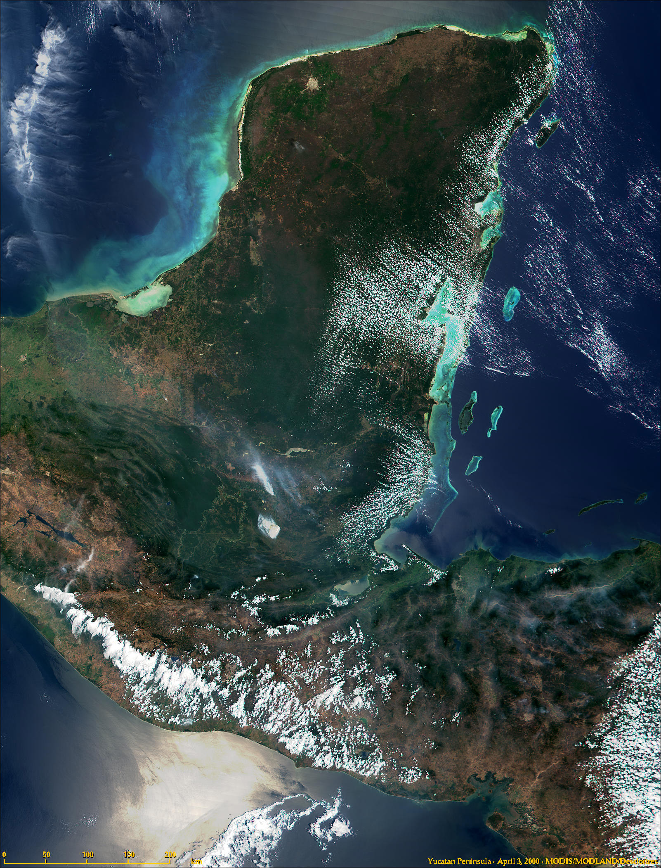
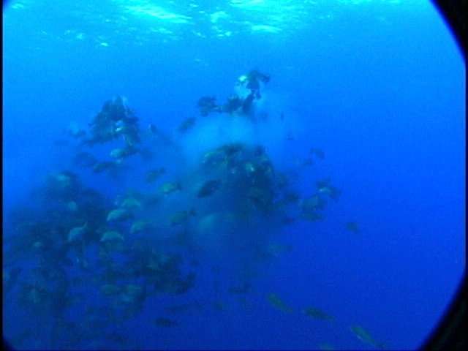
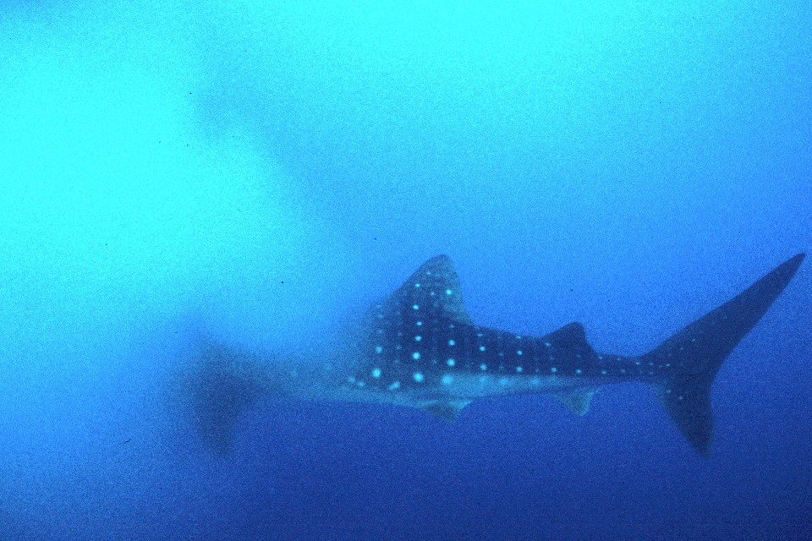
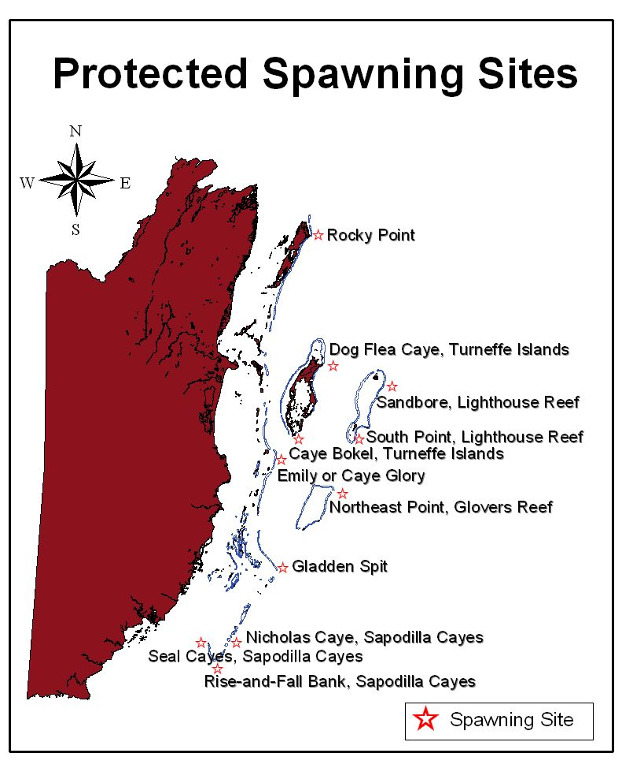
Mexico
Gladden Spit FSA
Peak spawning period for Cubera (Lutjanus cyanopterus) and Dog (L. jocu) March –June¹
22 Juvenile male whale sharks² externally tagged with V32 and V16 Vemco acoustic tags in April 2000 and April 2001
Acoustic receivers deployed at the spawning site and 24 other locations throughout Belize.
Belize
Guatemala
1. Heyman, W., Graham, R, et al. 2001
2. Graham, R. and Roberts, C. 2007
NASA/MODIS 2000
Honduras

Slide 4
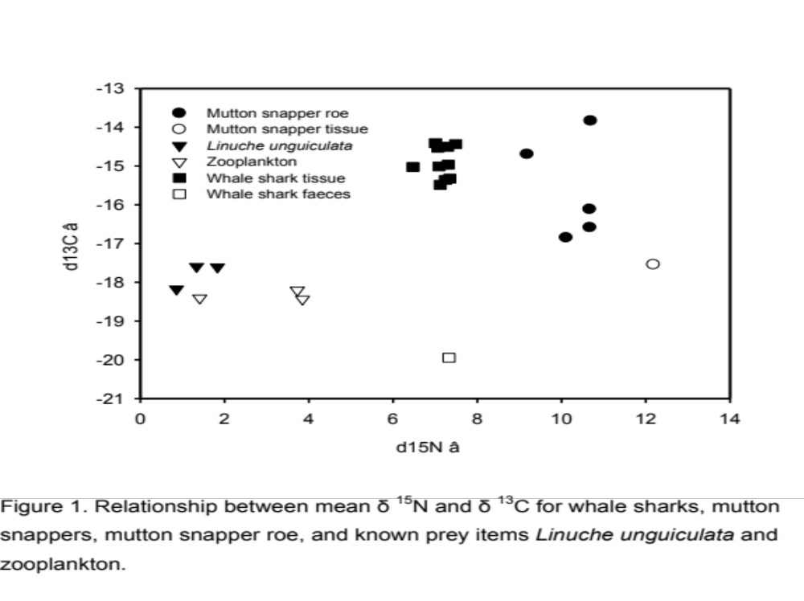
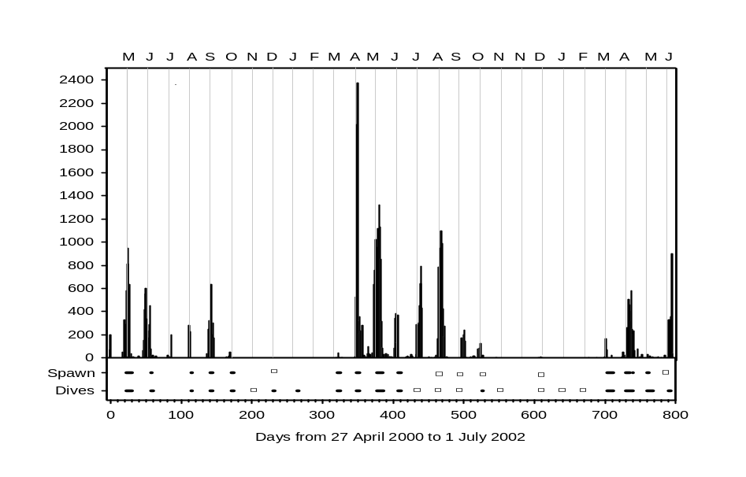
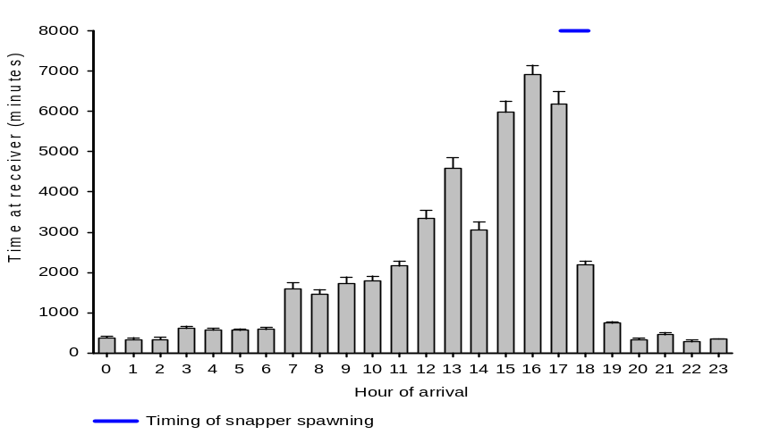
Whale shark use of Gladden Spit FSA
1
2

Slide 5
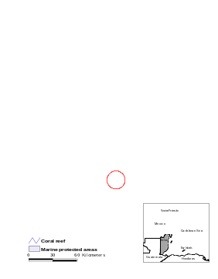
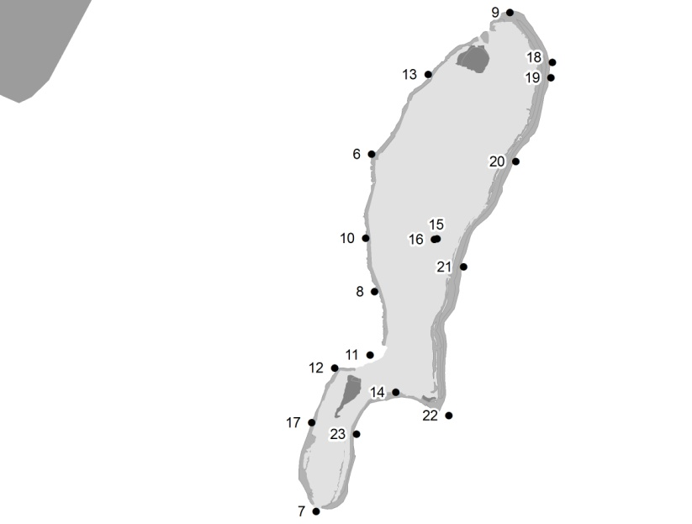
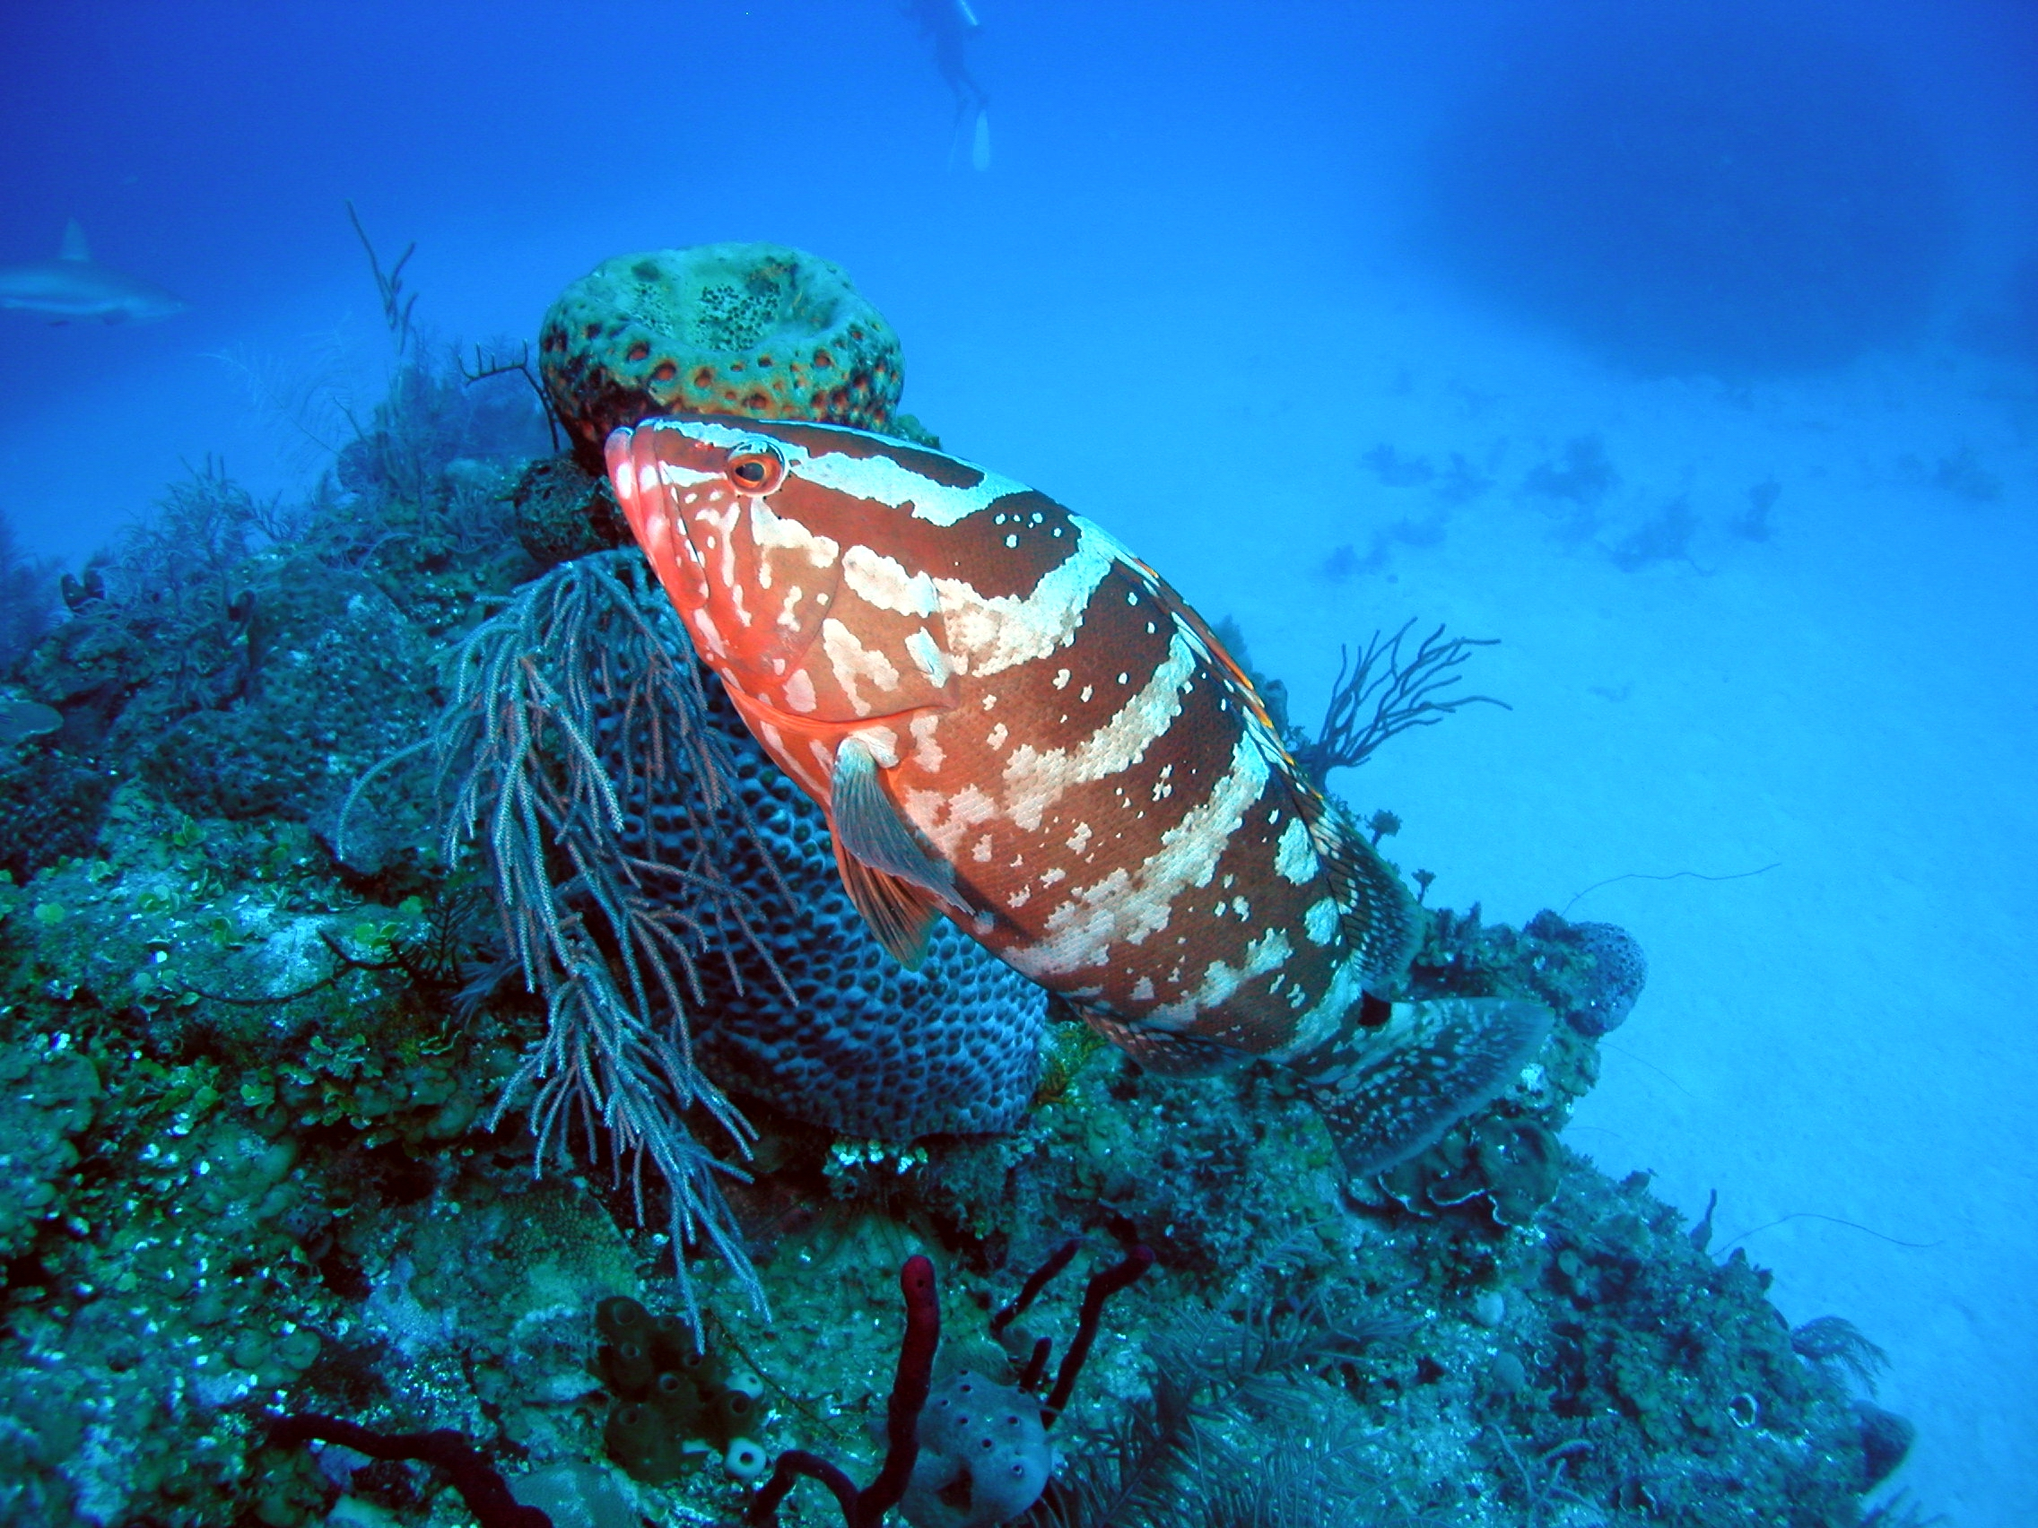
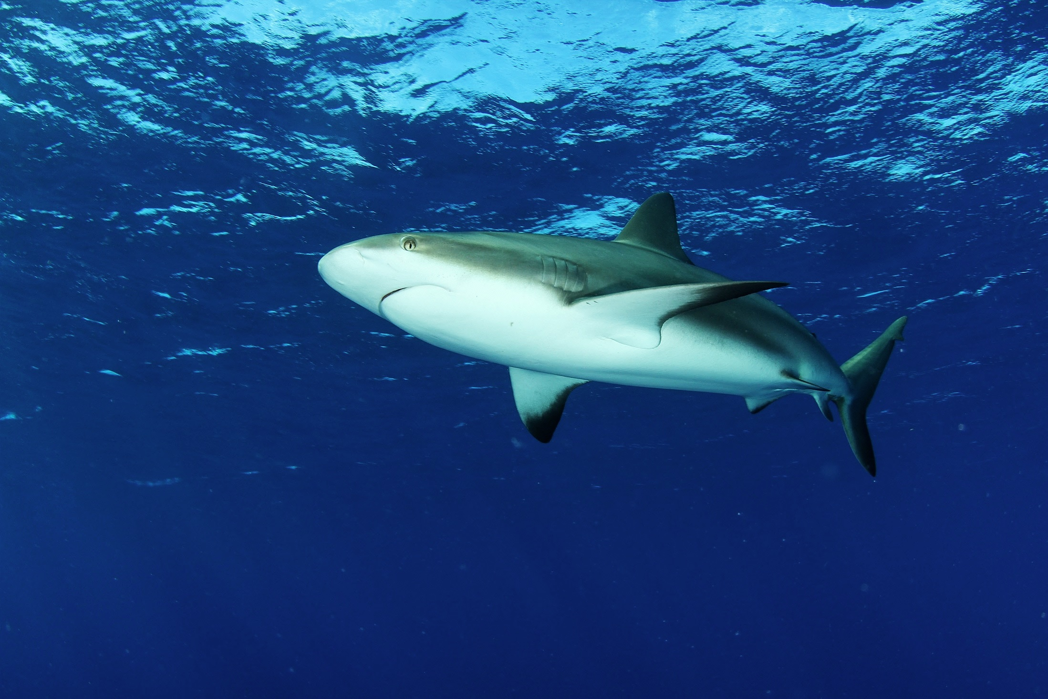
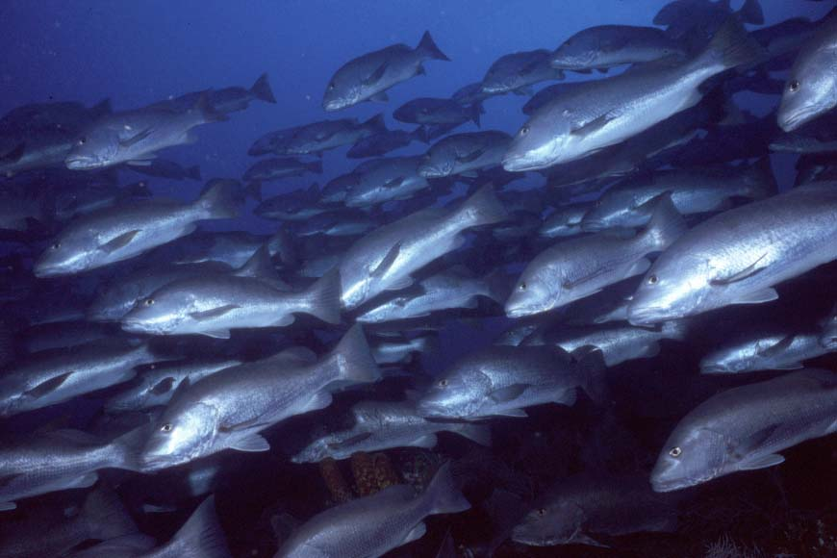
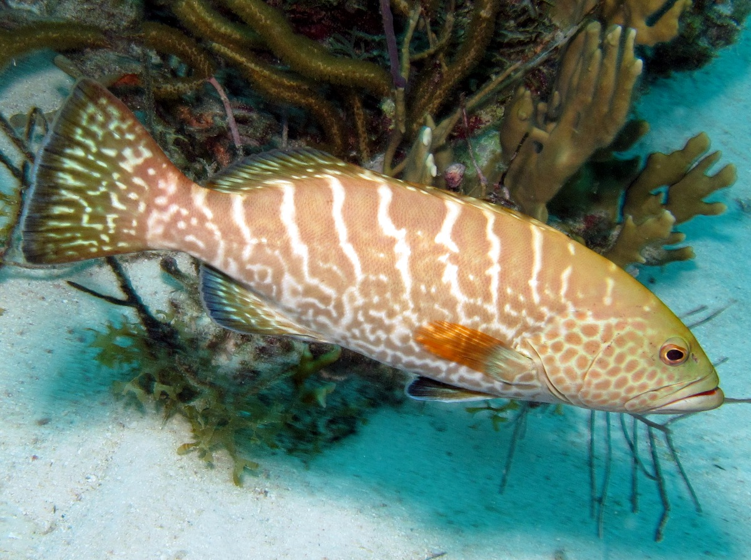
Lighthouse Reef Atoll – 3 FSAs
1
n=58
C. perezi, n=95
2
3
F. Charpin
Notes:
Michele Heupel
For each individual shark, the time spent inside was di- vided by the total time monitored (first detection to last) to deter- mine the proportion of time spent in MPAs. Time spent inside was also calculated by month for each species to define seasonal changes in MPA use. Proportion of time data was examined for normality with Quantile–Quantile plots and sin􏰆1px transformed. A t- test was used to test for a difference in the proportion of time spent inside MPAs between species. A mixed effects model with individual as a repeated measure was used to test for differences in the proportion of time spent inside MPAs by year, month, body size, sex and MPA.
Spatio temporal use of FSA (map with arrows histo or pies of time use
How important are FSA to reef-sharks? (% time at FSA versus outside, sex/onto differences)
Where do they go when not at FSA? (maps)
What potential impact do sharks have on FSA? (may or may not have time for this and
Management aspects – predictability and competition w fishers
Specific to LRA
Season of Nassau grouper spawning (refs: Sadovy, claro, Sala) relative importance in distributional range eg pops counted
Locations of spags (3) only one Nassau
Number of sharks tagged w focus on the Caribbean Reef
Which FSA preferentially targeted and by which sharks/demographics
Nassau counts at Glovers declined from 3,000 fish in 1999 to less than 600 in 2007 but rebounded to over 1,500!
11% LEGAL fishing mortality a year!
Closed season for Nassau grouper implemented from 1 December through 31 March
Many animals still captured outside of the closed season, often with spearguns
Spear fishing banned inside MPAs but not enforced
Yannis 2009: Repeat horizontal movements along forereef habitats consisted of relatively straight movements, which theoretical models consider the most efficient search strategy when forage patches may be spatially and temporally unpredictable. Although sharks moved using a direct walk while in patches, they appeared to move randomly between patches.
Sharks had significantly lower rates of movement during the nocturnal flood tide than the ebb tide. The reduced rates of movements for the sharks at Palmyra with the flood tides corresponds with the influx of cooler water and subsequent decrease in water temperature (up to 38C, NOAA Coral Reef Ecosystem Division: Appendix J). There are three potential explanations for reduced swimming speeds during this time period: (1) reduced metabolic rates caused by lower temperature, (2) reduced swim speeds due to foraging in small patches, and (3) decreased swim speeds from reduced search behavior and foraging.

Slide 6
Sandbore FSA
Nassau grouper FSA existence determined through fisheries landings and UVC
December-February spawning
Very few shark detections: 3096
Mix of male and female juvenile sharks
Possible strong fishing pressure and removal of larger animals.

Slide 7
Half Moon Caye FSA
Multi-species snapper and carangid FSA based on UVC
March-July peak spawning for observed snapper and carangid species
Shark detections: 346,724
3 sharks = >90% of detections; mature females
Need additional UVC to assess reasons for visitation Sept-March

Slide 8
South Point FSA
Tiger grouper FSA based on UVC
Feb-March peak (see Sadovy 1994)
Shark detections: 394,995
6 sharks = >85% of detections, dominated by females
High FSA site fidelity: >99% of total Lighthouse detections for 3 sharks at 2 FSAs
Site is now targeted by net and longline fishers
Detections

Slide 9
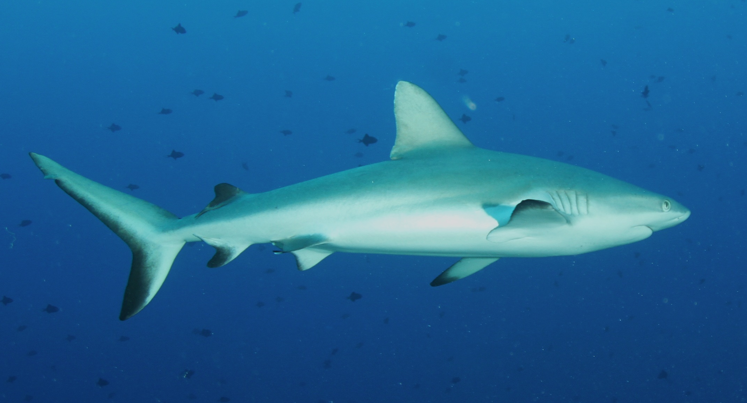
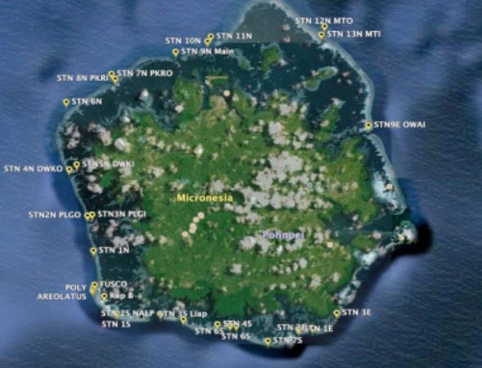
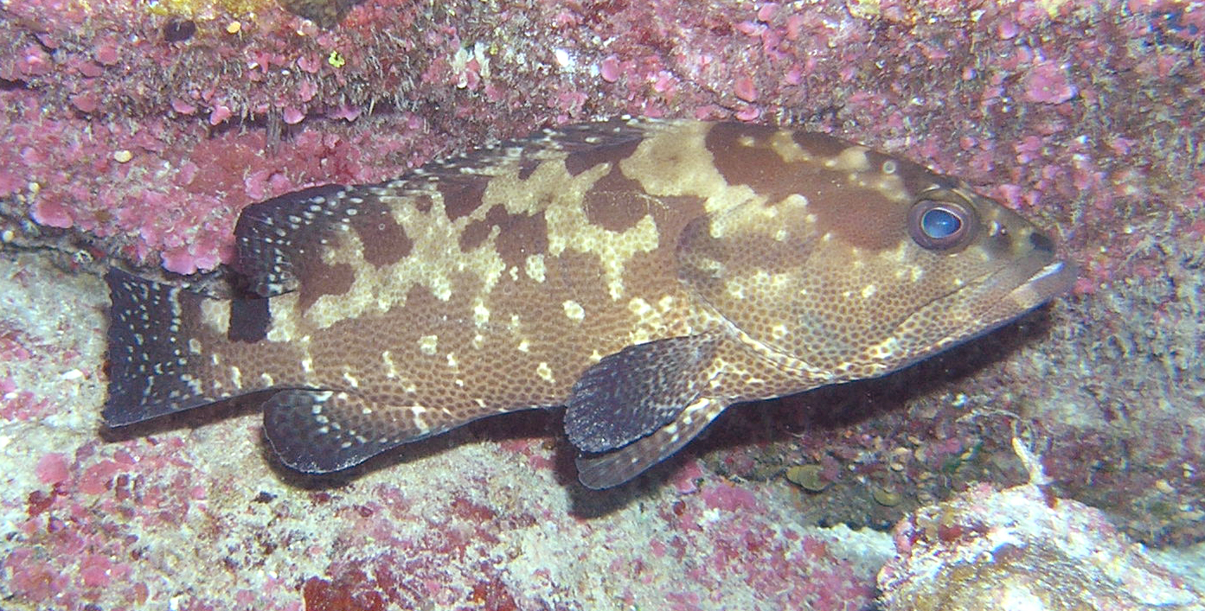
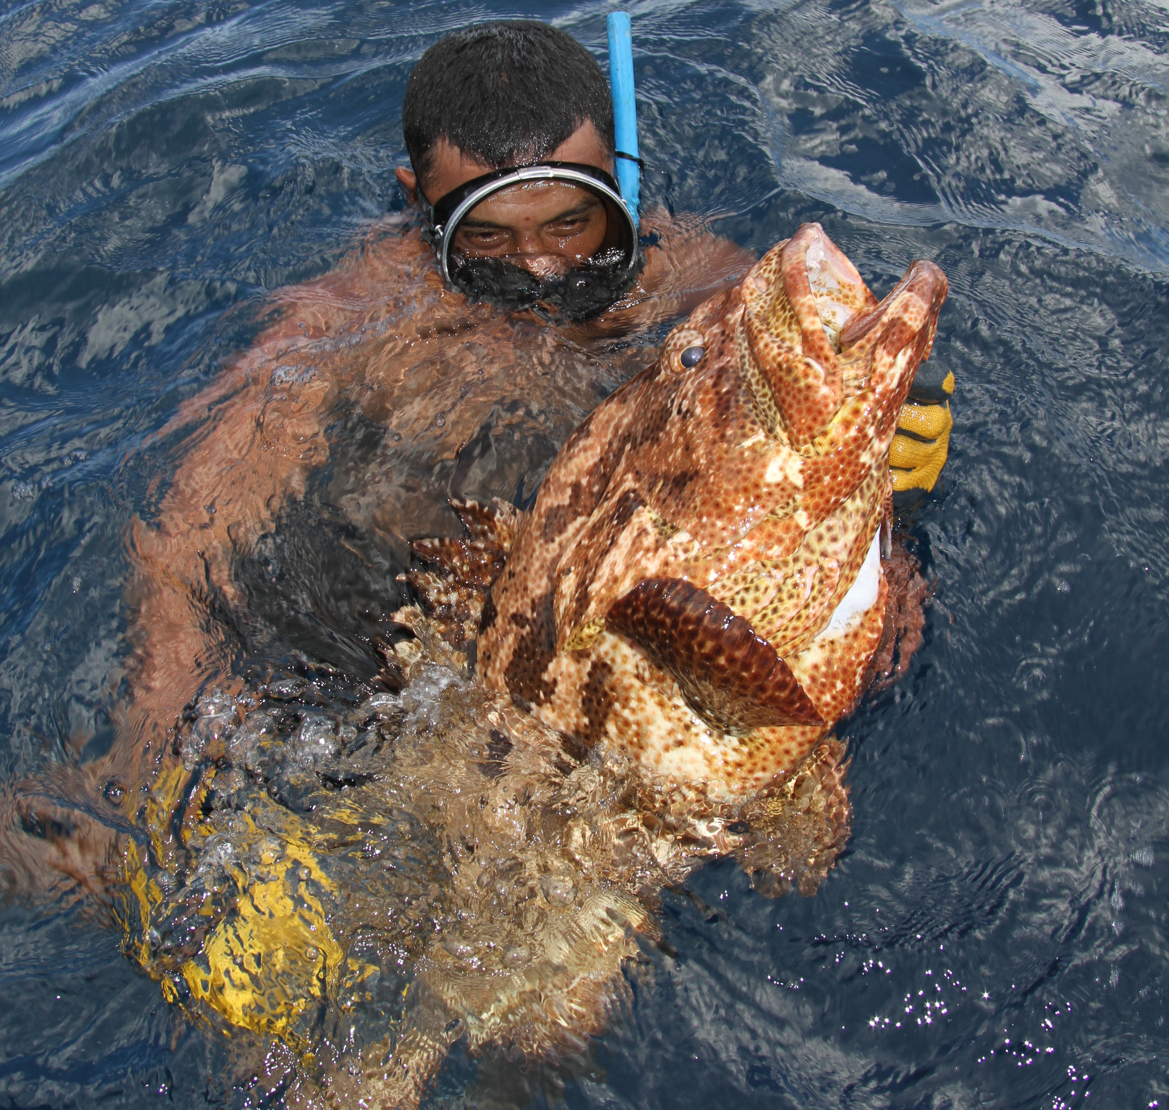
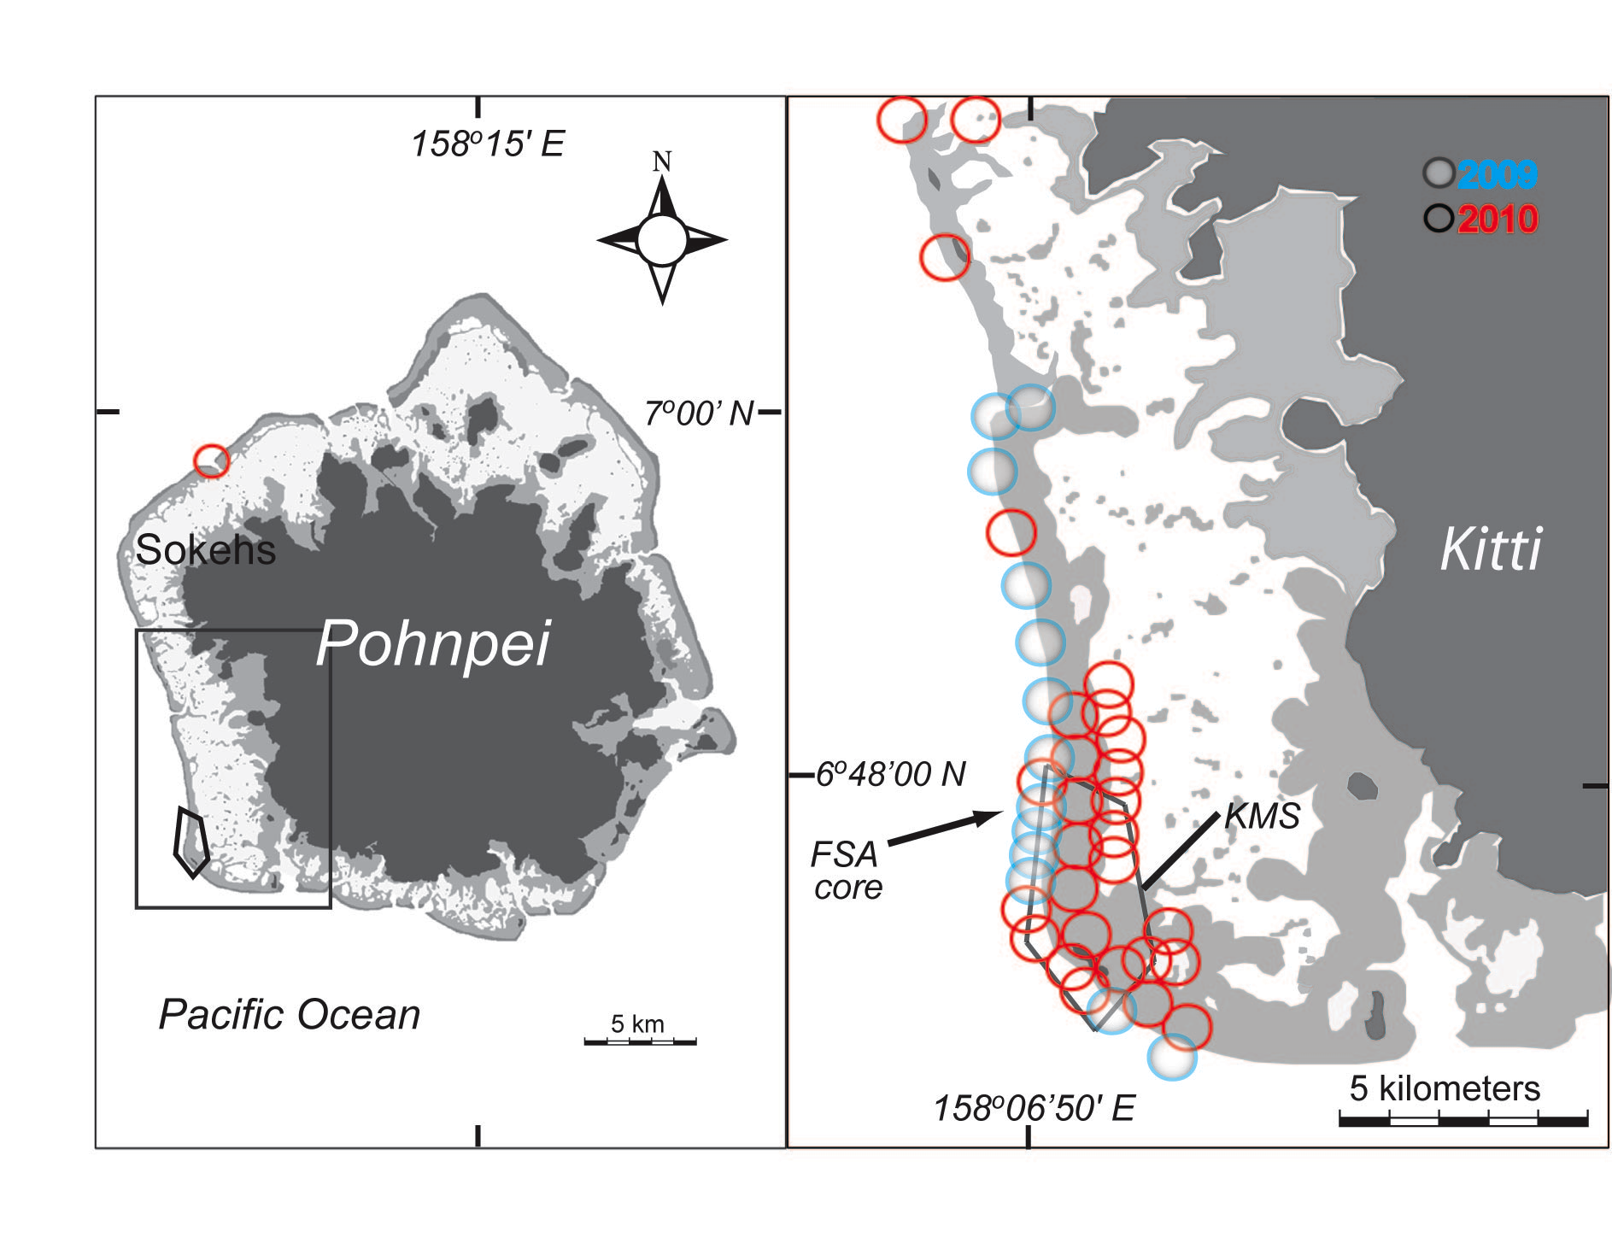
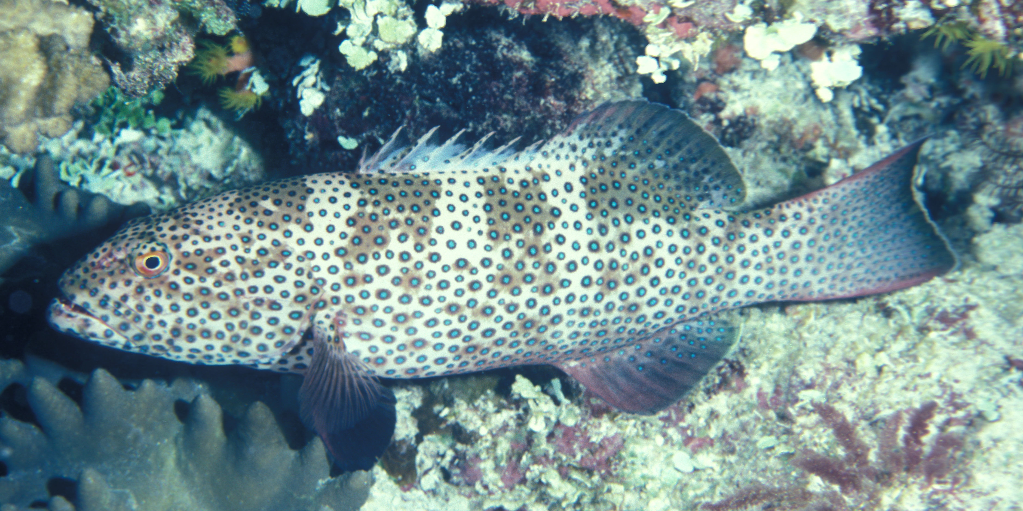
Pohnpei, FSM
Acoustic array with 44 receivers, focused on Kephara and ringing Pohnpei; additional 15 receivers at Ant Atoll (10km distant)
Focus of tagging at 3 FSA located along 500m and inside the marine sanctuary
  Camouflage grouper Epinephelus polyphekadion
  Brown-marbled grouper E. fuscoguttatus
  Squaretail coralgrouper Plectropomus areolatus
16 Grey reef tagged internally with 5 yr V16-6H
All mature females; Mean 152±3.6 cm (Range 147-154 cm TL)
E. Joseph
SCRFA
Notes:
general spawning times are: poly-feb-april, with either feb-mar or mar-apr; fusco-feb-apr; areo-usually jan-may, but occasionally feb-jun; spawning typically on full moon, arrival times vary but probably on average 7-12 days at the site per month. no evidence of spawning times
longer residency time for males for all species. fusco and areo usually one month for females, all or most months for males. poly is a bit weird. females ofter both months, same as males, but can be one month for both sexes, too. poly is gonochore, fusco is def protogyne, jury still out on areolatus, but indications of sex change
Spatio temporal use of FSA (map with arrows histo or pies of time use
How important are FSA to reef-sharks? (% time at FSA versus outside, sex/onto differences)
Where do they go when not at FSA? (maps)
What potential impact do sharks have on FSA? (may or may not have time for this and
Management aspects – predictability and competition w fishers
Specific to Pohnpei:
Number and brief description of the FSA known and conservation status
Preferential use of the FSAs according to Grey reefs that are primarily female of reproductive age or gravid
Movement away from FSA and behaviour in relation to FSA activity eg Ant Atoll

Slide 10
Pohnpei Results
All tagged sharks patrol the 3 FSAs but one female dominated the Poly FSA
Sharks moved throughout the island and 2 moved offshore (40km) across deep waters to the Ant Atoll FSA

Slide 11
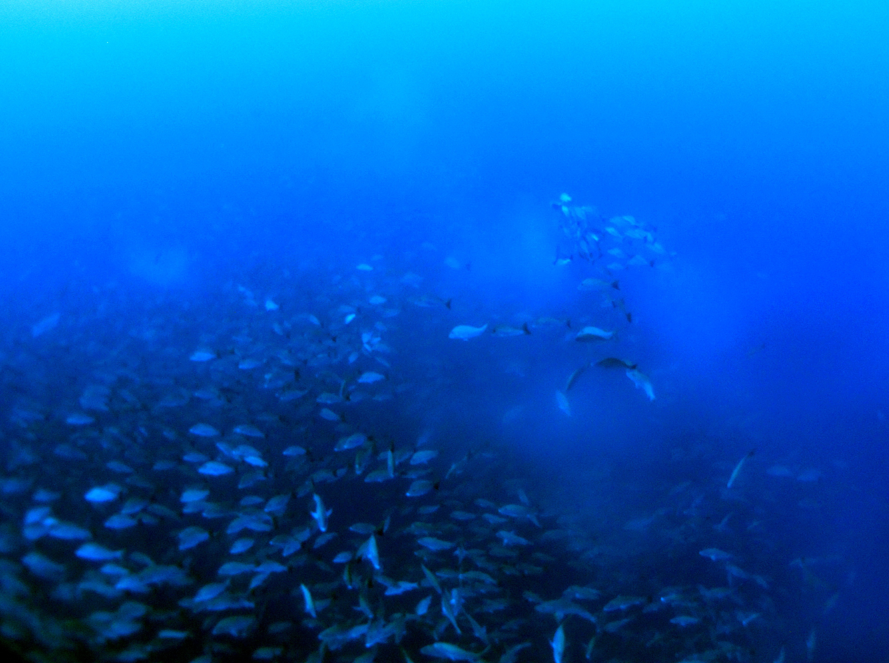
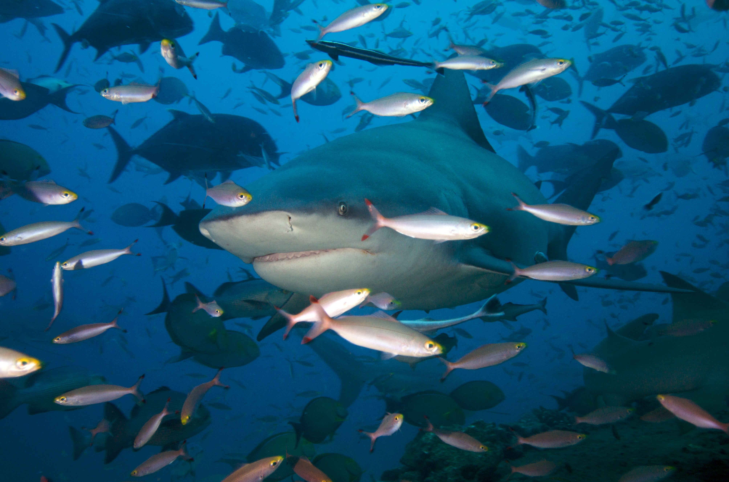
Summary
Work is still preliminary but some emerging patterns:
  FSAs are important to a portion of the reef shark population, often mature females that dominate the site.
  Tagged RAS demonstrate strong site fidelity and as a source of predictable provisioning especially for gravid females
Predictability of sharks and FSA make them key fisheries targets but also provide cost-effective means of managing vulnerable source populations and in select cases can provide an economic alternative to fisheries
Continued support for the creation and enforcement of seasonal closures and MPAs that encompass FSA sites are key management strategies that will benefit RAS and FSA.
S. Heinrichs

Slide 12
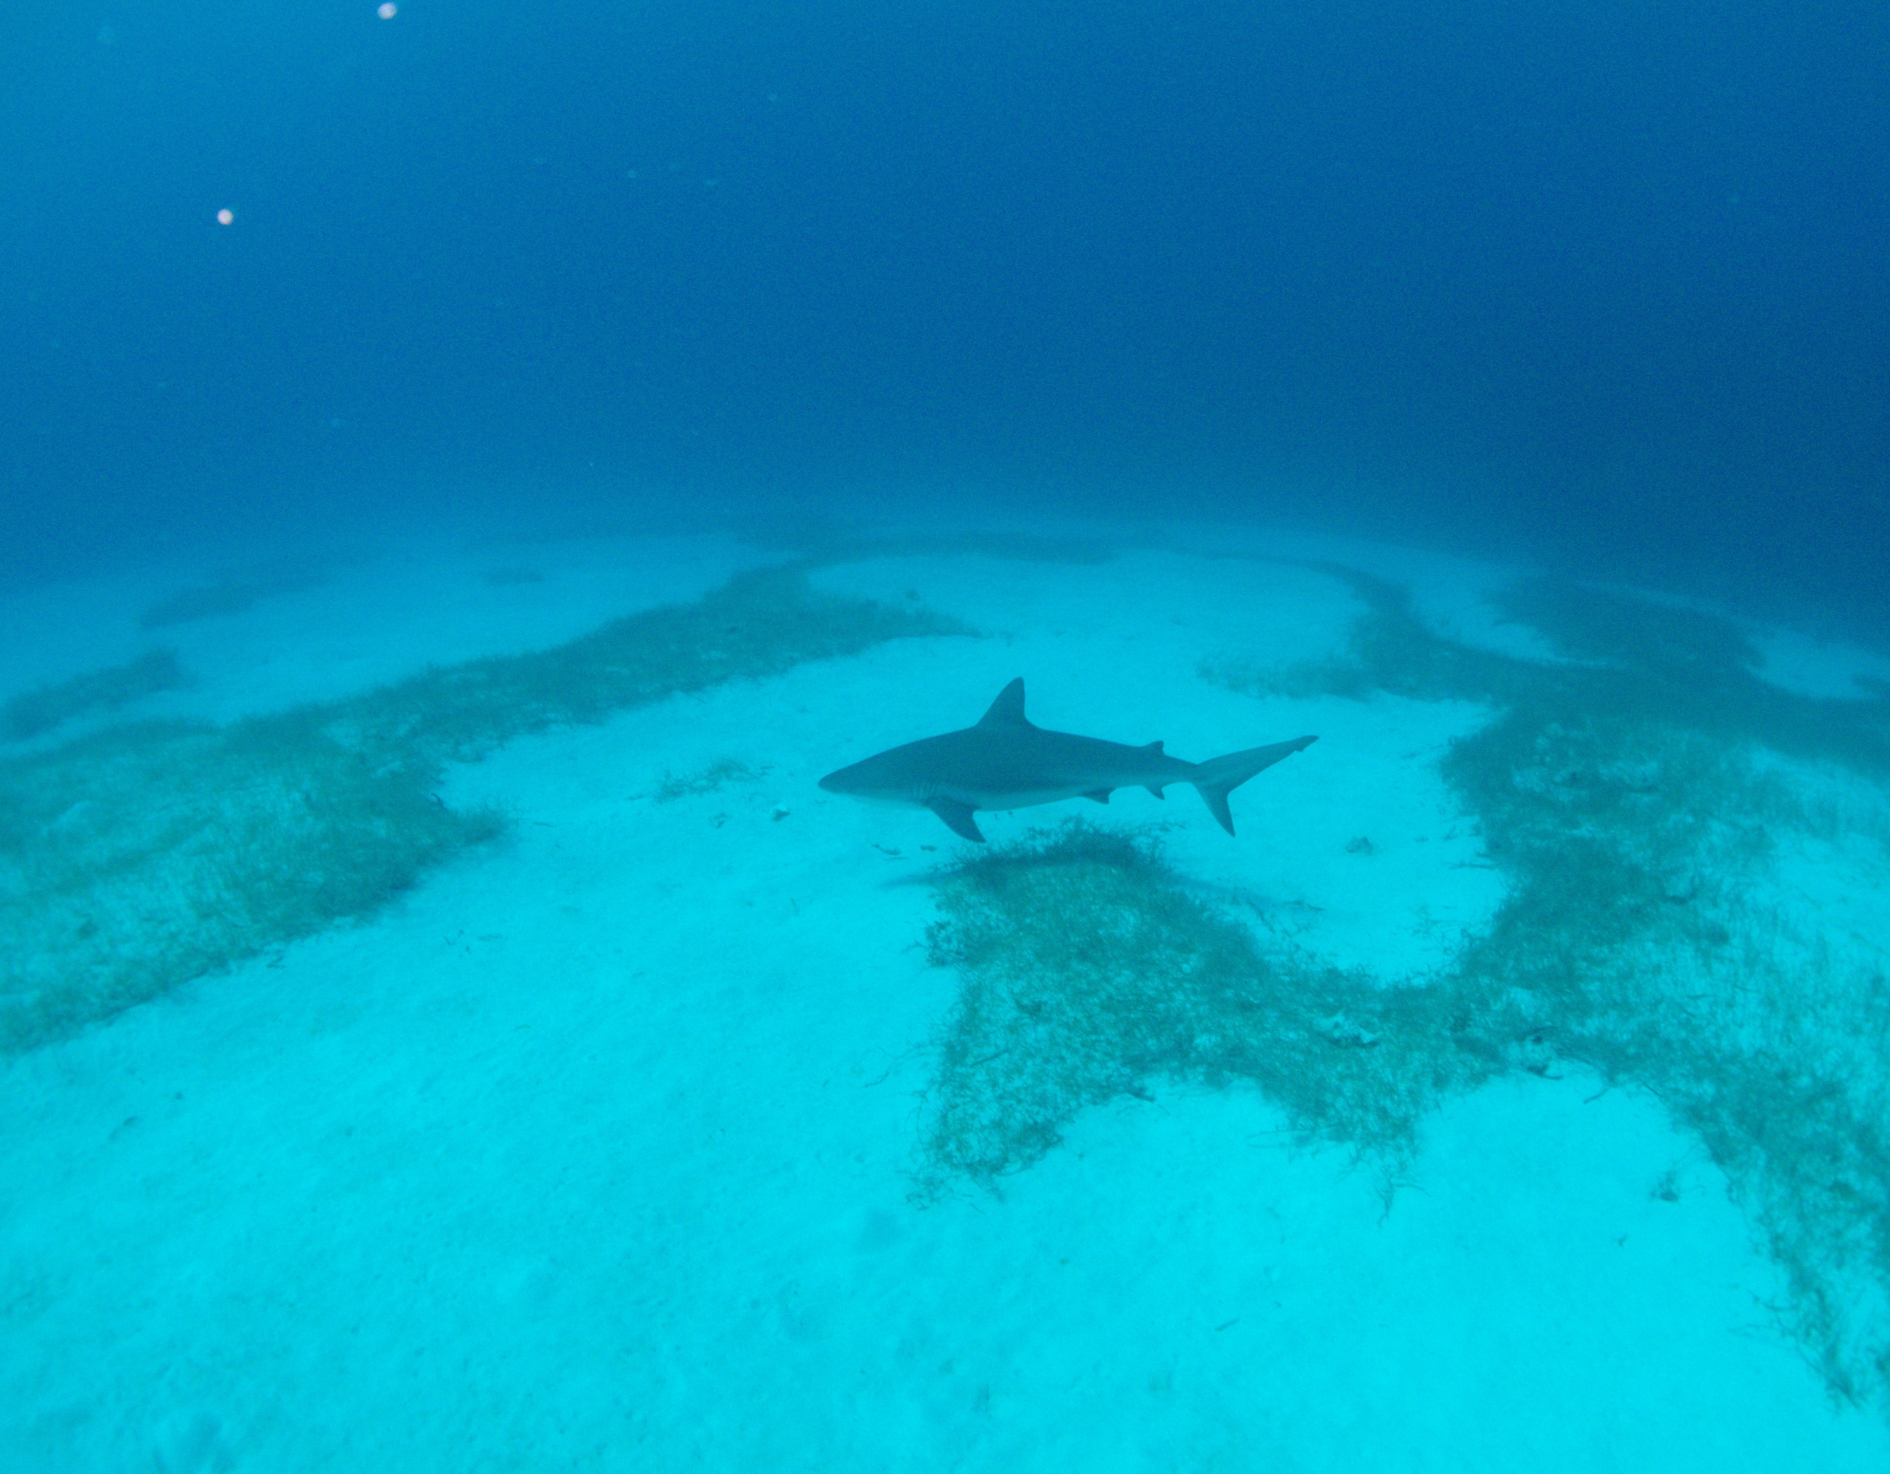
Thank you!
Partners
Belize Fisheries Department
Belize Forestry Department
Belize Audubon Society
Southern Environmental Association
Fishers & guides from S. Belize
Pohnpei Department of Lands and Natural Resources
Julie Robinson, The Nature Conservancy
Dr. Matt Witt, University of Exeter
Funding
The Summit Foundation
Belize Diving Services Fund
UFL Program for Shark Research
UK Darwin Initiative
Pohnpei Department of Lands and Natural Resources
Saltenstal-Kennedy Grant
Western Pacific Coral Reef Institute
National Fish and Wildlife Foundation NOAA
Contact: rgraham@wcs.org

